Slide 1
Introduction to .Net
Notes:
Module 1: Getting Started with Databases and Transact-SQL in SQL Server 2008
Course 2778A
Presentation: 60 minutes
Lab: 60 minutes
This module helps students to : get started with databases and transact-SQL in SQL server 2008.
After completing this module, students will be able to:
Understand SQL Server 2008
Understand SQL Server Databases
Understand the SQL Language
Understand syntax Elements of T-SQL
Work with T-SQL Scripts
Use T-SQL Querying Tools
Required materials
To teach this module, you need the Microsoft Office PowerPoint® file 2778A_01.ppt.
Important It is recommended that you use PowerPoint 2002 or a later version to display the slides for this course. If you use PowerPoint Viewer or an earlier version of PowerPoint, all the features of the slides might not be displayed correctly.
Preparation tasks
To prepare for this module:
Read all of the materials for this module.
Practice performing the demonstrations and the lab exercises.
Work through the Module Review and Takeaways section and determine how you will use this
section to reinforce student learning and promote knowledge transfer to on-the-job performance.
Make sure that students are aware that there are additional information and resources for the module on the Course Companion CD.

Slide 2
.NET Fundamentals
.NET Initiative
.NET Framework
Language Support
Common Language Runtime
Common Language Specification
Application execution/Managed Code Execution
Namespace
Notes:
Module 1: Getting Started with Databases and Transact-SQL in SQL Server 2008
Course 2778A

Slide 3
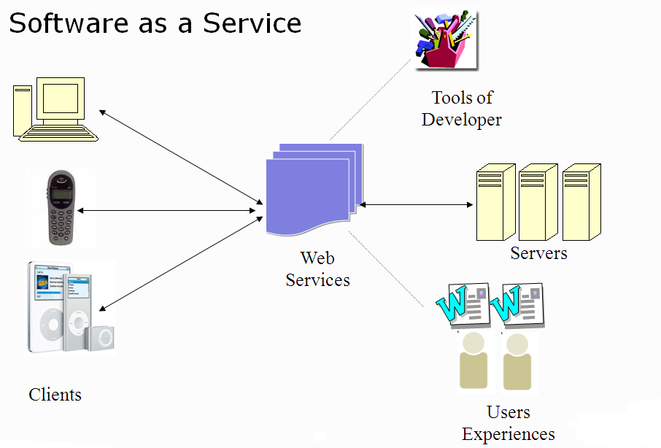
Enterprise Application

Slide 4
Building an Enterprise Application
Would my application be able to support a set of thousand more users?
Would the service be available for 24x7?
Would the response time suffer if user load increase?
Would the data integrity be maintained?
How easy it would be to fiddle around the components of running system?

Slide 5
Building an Enterprise Application
Would the hardware resource requirements increase day by day with increasing user load?
Would my application be able to get integrated with external applications smoothly?
Will anybody be able to hack, steal or corrupt my confidential data?
And many more …

Slide 6
Quality of Service Requirements
Scalability
Availability
Performance
Flexibility
Security
Re-usability

Slide 7
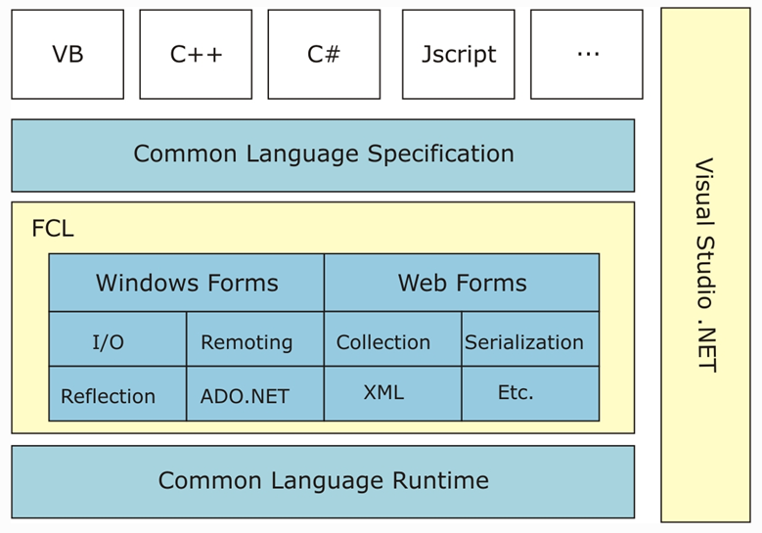
.NET Framework

Slide 8
.NET Languages
Key features of .NET Languages
  Standardized by ECMA
  Component based
  Object-oriented
  Robust and durable code
New languages created for .NET i.e.
  C#, VB.NET, J#, ……etc. (more than 25)

Slide 9
Common Language Runtime (CLR)
Execution engine for managed code (MSIL code)
Services of CLR
  Secure Execution of code
  Automatic Memory Management
  Interoperability
  Exception Handling

Slide 10
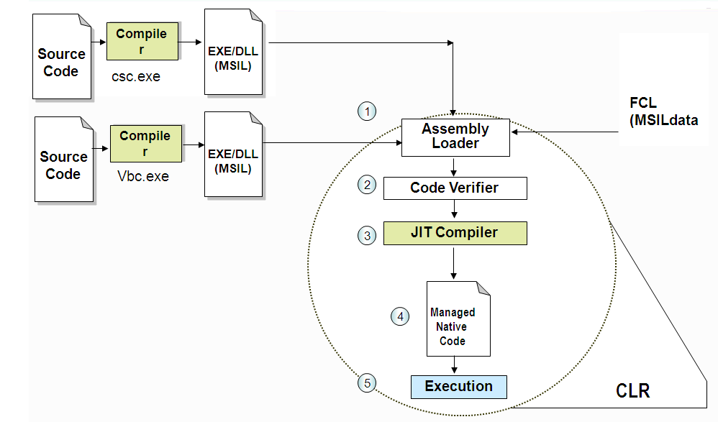
Execution of .NET Application

Slide 11
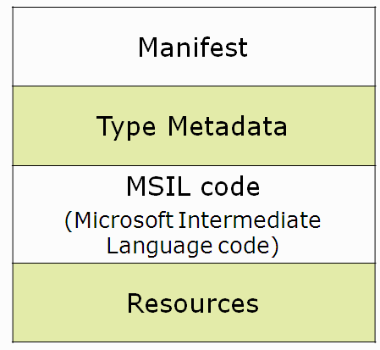
Assembly
Assembly is a logical unit of deployment
Main Components of Assembly

Slide 12
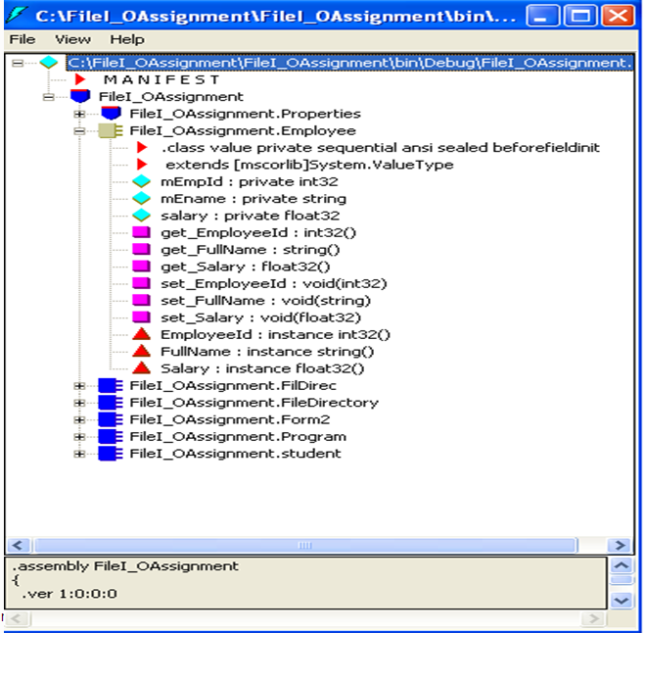
Disassembly

Slide 13
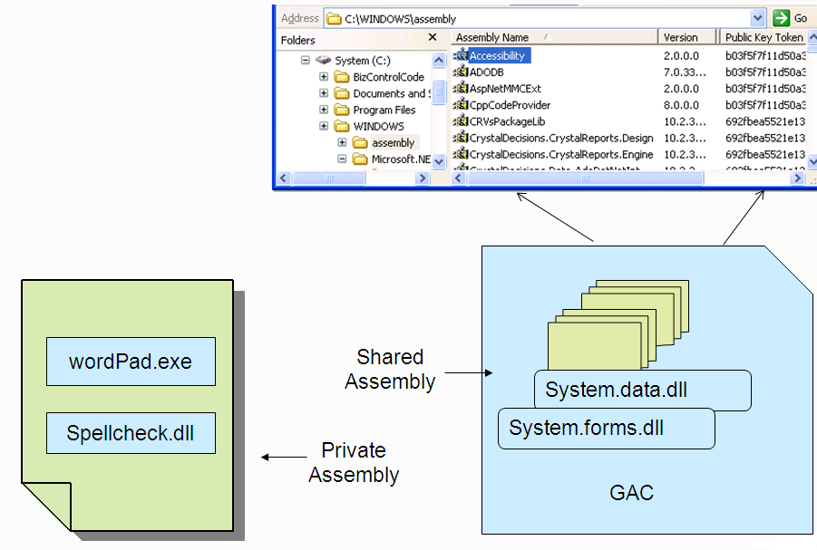
Types of Assembly

Slide 14
Common Language Specification (CLS)
Ensures source code compiled by .NET compiler interoperates with .NET Framework.
CLS describe a set of features that different languages have in common.
The CLS includes a subset of the Common Type System (CTS).
The CTS defines the rules concerning data types.
Any program which uses CLS-compliant types can interoperate with any .NET program written in any language.
.NET languages support both CLS and CTS.

Slide 15
Common Type System (CTS)
Enables cross-language integration, type safety, and high performance code execution.
Provides an object-oriented model where all types are derived from common class, System.Object
Supports two main categories:
  Value types
  Reference types

Slide 16
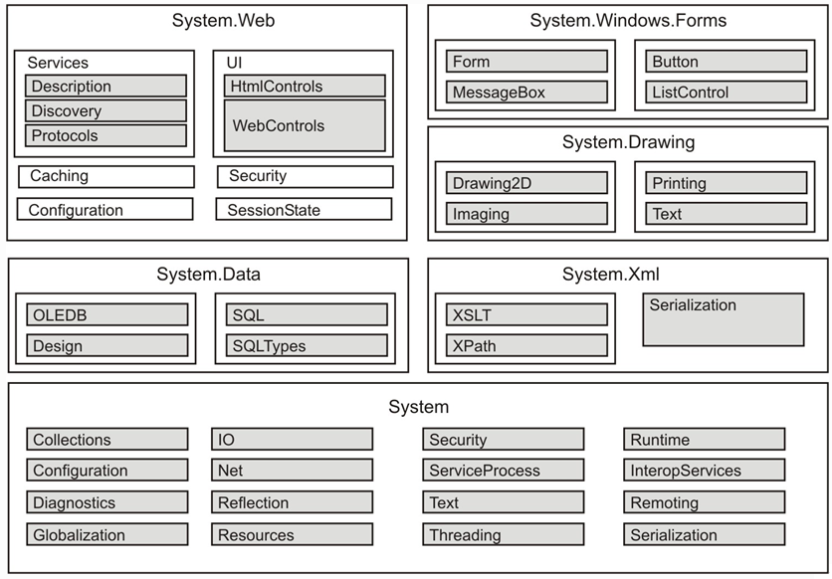
Framework Class Library (FCL)

Slide 17
Windows Forms
Framework for building rich clients
Rich set of controls
Extensible controls
Data-aware
ActiveX support
Printing support
Advanced graphics (GDI+)

Slide 18

Web Forms
Built with ASP.NET
  Logical evolution of Active Server Page
  Similar development model: edit the page and go
  Require less code
New Programming model
  Event-driven/server-side control
  Rich controls(e.g. data grid, validation)
  Data binding
  Simplified handling of page state

Slide 19
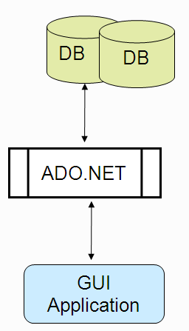
ADO.NET
Object model for data access
Supports two style of data access
  Connected
  Disconnected
Support data binding
Can view and process data relationally (tables) or hierarchically (XML)

Slide 20
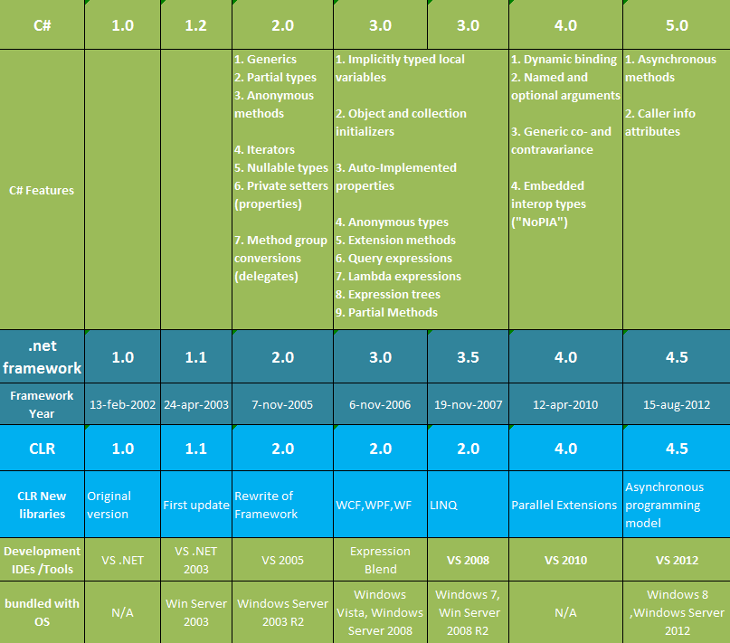
Versions

Slide 21
Visual Studio.NET
The Design goals are
  Maximize developer Productivity
  Simplify Server based Development
  Deliver Powerful Design Tools
RAD (Rapid Application Development Tool) for next generation internet
  Forms Designer
    For creating ASP.NET web form pages
  Server Explorer
    For accessing web services
Enhanced RAD support for creating your own components.

Slide 22
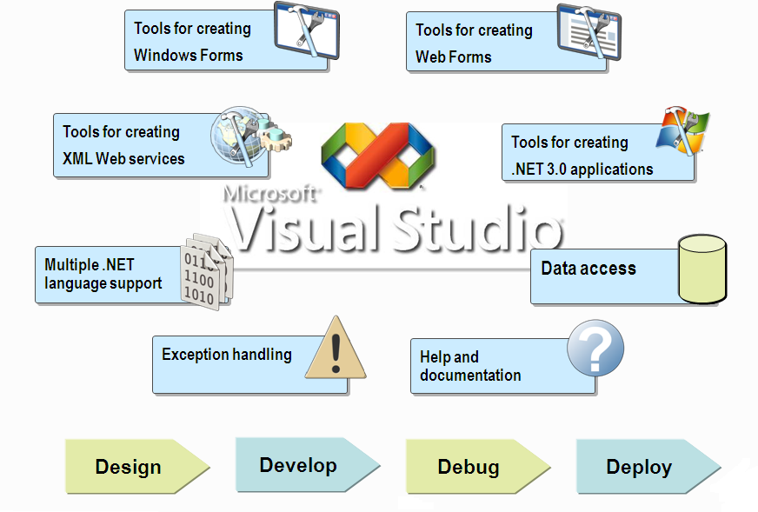
Visual Studio.NET as IDE

Slide 23
Quick Recap …
.NET is Microsoft’s new Initiative to treat software as service.
.NET framework provides cross language Interoperability using CTS.
CLR is an execution engine of .NET Platform.
CLR executes managed code which is IL (intermediate Language code).
Assembly is a logical unit of deployment.
Notes:
Module 1: Getting Started with Databases and Transact-SQL in SQL Server 2008
Course 2778A

